Slide 1

Angelbeat
Jan 25 2018
Bentonville, Arkansas

Slide 2

About Me
Shawn Weisfeld
Cloud Solution Architect
Microsoft – One Commercial Partner Technical Team
sweisfel@microsoft.com
Austin, TX
Download Slides @ https://aka.ms/Angelbeat/Shawn

Slide 3


Watch User Group presentations for FREE online! We now have over 700 presentations online
Miss a User Group meeting?
Forget something that you learned?
Want to see content from a User Group not in your area?
Want to share with a buddy?
Presentations from the thought leaders on the topics you care about including:
Agile
Azure
C#
Entity Framework
HTML5
MVC
SQL
jQuery
and Much More!
We know you cannot make it to every session,
that is why we post them online for you!
New Content added all the time!
For new content announcements
@UserGroupTV
http://www.UserGroup.tv

Slide 4
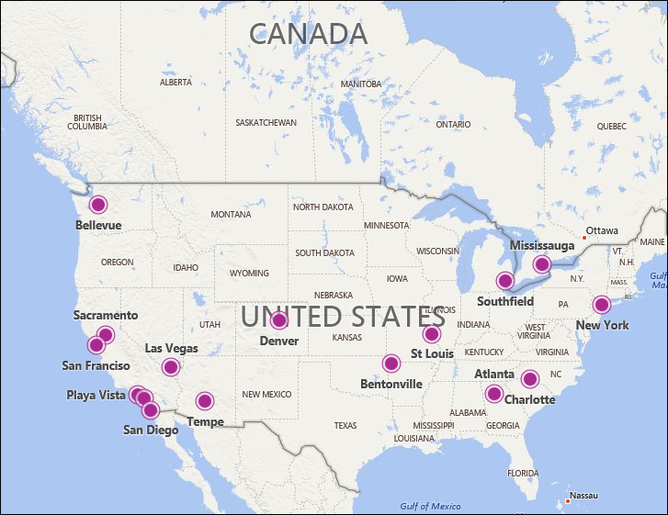
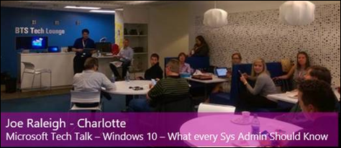
What are Microsoft Tech Talks?
Microsoft Tech Talks is a Technical Community event, designed to bring IT leaders in the local area together at a Microsoft facility or alternative venue, for deep Microsoft-technology based discussions, and
An opportunity to network and share with local Microsoft Services Professionals and other IT professionals.
A Microsoft Services presenter delivers a technically-rich presentation covering a product, product feature, or service that Microsoft offers,
Our presenters are world-class Subject Matter Experts and trusted advisors to our highly-valued customers.
Our meetings are a great opportunity to 'ask the experts' questions about their given field of expertise.
Subjects vary from session to session and attempt to be at the leading edge, showcasing our latest features and products available.
These communities now collectively have over 3500 members that have joined one of the local meetup groups.
We are constantly expanding to a region near you, your friends / colleagues…..
http://aka.ms/mtt
CURRENTLY OPERATING IN: Atlanta | Bellevue | Charlotte | Denver| Las Vegas |
So-Cal (San Diego, Irvine) | New York | Mississauga | Mountain View | North-West Arkansas |
St. Louis | Sacramento | Southfield | Tempe

Slide 5
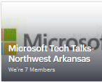
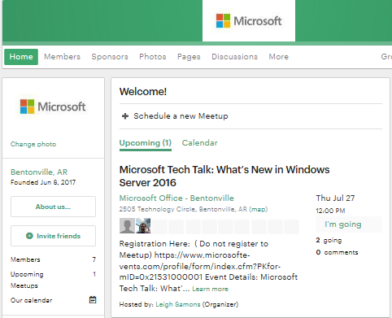
We are on meetup!!!
http://meetup.com/mttnwa
Join Us
Join Other Groups
RSVP Closed does not mean Closed! Look for the Microsoft Events sign-up link!
We send details of other events out
Look out for poll Qs
Tell all your friends / colleagues
Group Review!!
Notes:
Join our Meetup. If you have not already we encourage you to join out MTT NWA meetup as this is where we will publish the events first. Don’t worry that it shows RSVP closed, we do that so that you can register through the Microsoft events page like most of you did that are here today.

Slide 6
Next Microsoft Tech Talk
^{February 7th, 2018}
Empowering with improved productivity – What’s new in Office 365 with Colin Page and Naga Divakarla
This session provides you an introduction of new features in Office 365 focusing on Exchange Online, SharePoint Online and Outlook. We will cover topics such as Modern UI, Communication Sites, Team Sites, Office Groups, External Sharing, What’s new in OWA, Outlook and Exchange, Exchange Online Protection and Security Center.
SIGN UP TODAY: http://aka.ms/mttnwafeb

Slide 7
Cloud Strategies & Containers
Shawn Weisfeld
Cloud Solution Architect
Microsoft
9:40 – 10:00

Slide 8
Overview & features

Slide 9

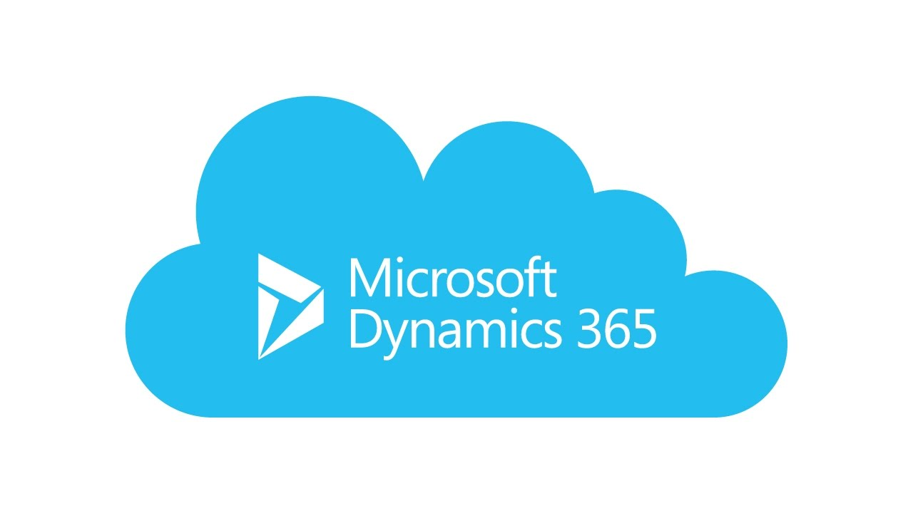
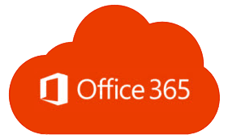
Overview Public Cloud Platform

Slide 10
Azure. Cloud for all.
Productive
Azure has more than 100 services with great end-to-end tools to make you successful.
Hybrid
Develop and deploy where you want, with the only consistent hybrid cloud on the market. Extend Azure on-premises with Azure Stack.
Intelligent
Create intelligent apps using powerful data and artificial intelligence services.
Trusted
Join startups, governments, and 90% of Fortune 500 businesses who run on the Microsoft Cloud today.
Productive
Hybrid
Intelligent
Trusted

Slide 11
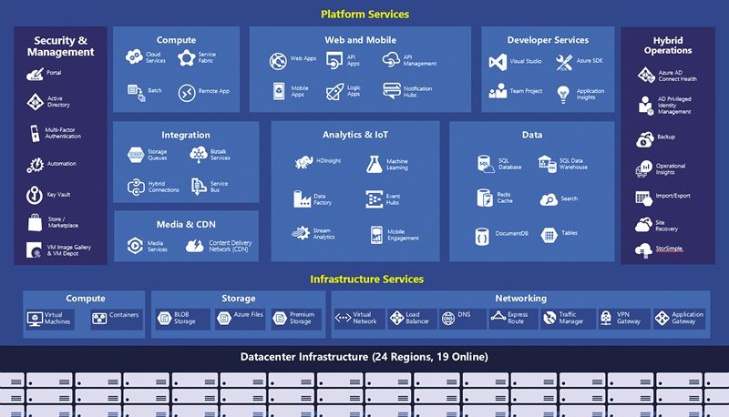
Productive
Hybrid
Intelligent
Trusted

Slide 12
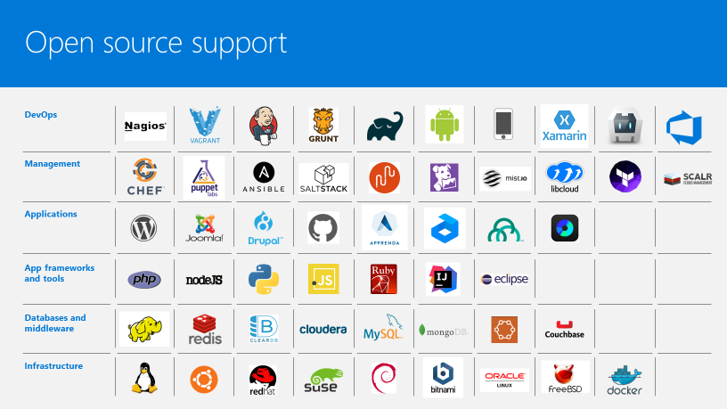


Productive
Hybrid
Intelligent
Trusted

Slide 13
The only consistent, hybrid cloud
Azure Active Directory
Azure services
Azure data services
Azure Security and Management
Productive
Hybrid
Common identity
Unified cloud platform
Data
platform
Security and management
Intelligent
Trusted
Active Directory
Azure
Stack
SQL
Server
On-premises infrastructure

Slide 14
Azure Stack: an extension of Azure
Productive
Hybrid
Intelligent
At the edge and disconnected
Meet every regulatory requirement
Cloud application model on-premises
Trusted

Slide 15
Comprehensive deep learning,
machine learning as a service
Productive
Hybrid
Customizable services
VS, ML STUB, Tensor, Caffe
Tools
Bots, Cognitive, ML
Infrastructure and compute
CPU, GPU, FPGA
Intelligent
Azure
Trusted

Slide 16




































More certifications than any cloud provider
GLOBAL
ISO 27001
ISO 27018
ISO 27017
ISO 22301
SOC 1 Type 2
Productive
SOC 2 Type 2
SOC 3
CSA STAR
Self-Assessment
CSA STAR
Certification
CSA STAR
Attestation
Hybrid
INDUSTRY
PCI DSS
Level 1
CDSA
MPAA
FACT UK
Shared
Assessments
FISC Japan
HIPAA / HITECH Act
Intelligent
HITRUST
GxP
21 CFR Part 11
MARS-E
IG Toolkit UK
FERPA
GLBA
FFIEC
REGIONAL
Argentina PDPA
EU
Model Clauses
UK
G-Cloud
China
DJCP
China
GB 18030
China
TRUCS
Singapore
MTCS
Australia
IRAP/CCSL
New Zealand
GCIO
Trusted
Japan My
Number Act
ENISA
IAF
Japan CS Mark Gold
Spain
ENS
Spain
DPA
India
MeitY
Canada
Privacy Laws
Privacy
Shield
Germany IT
Grundschutz
workbook

Slide 17
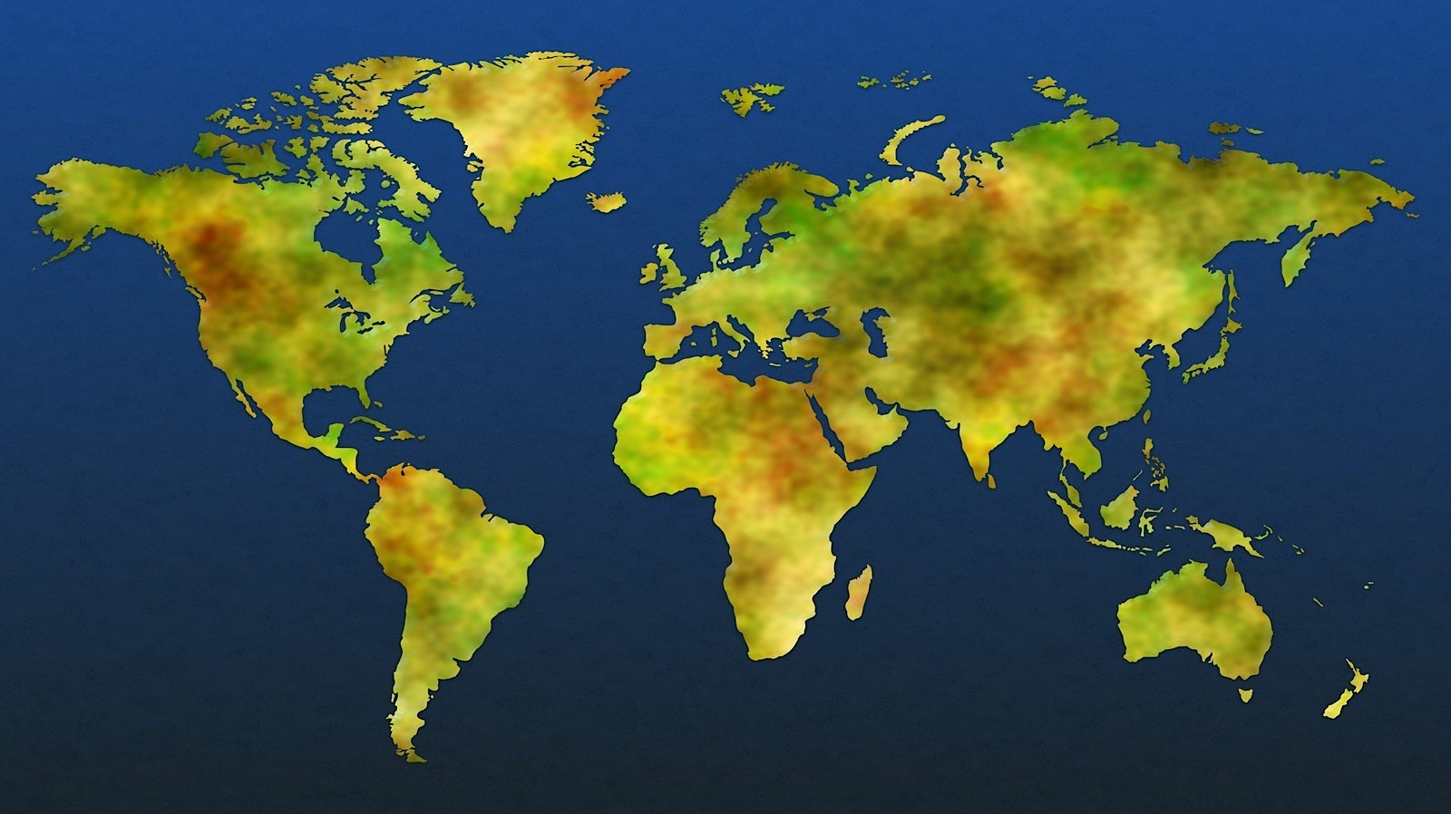



Datacenter security
Two-factor authentication with biometrics
Perimeter fencing
One defined access point
24x7x365 security operations
Verified single-person entry
Video coverage
Secure destruction bins
PERIMETER
BUILDING
2 Mil kilometers intra-datacenter fiber
72+
Tb per second
Backbone
42 Azure regions
100+ datacenters
Millions of servers
Inability to identify location of specific customer data
System check
Background check
Employee and contractor vetting
ACCESS APPROVAL
SERVER ENVIRONMENT

Slide 18
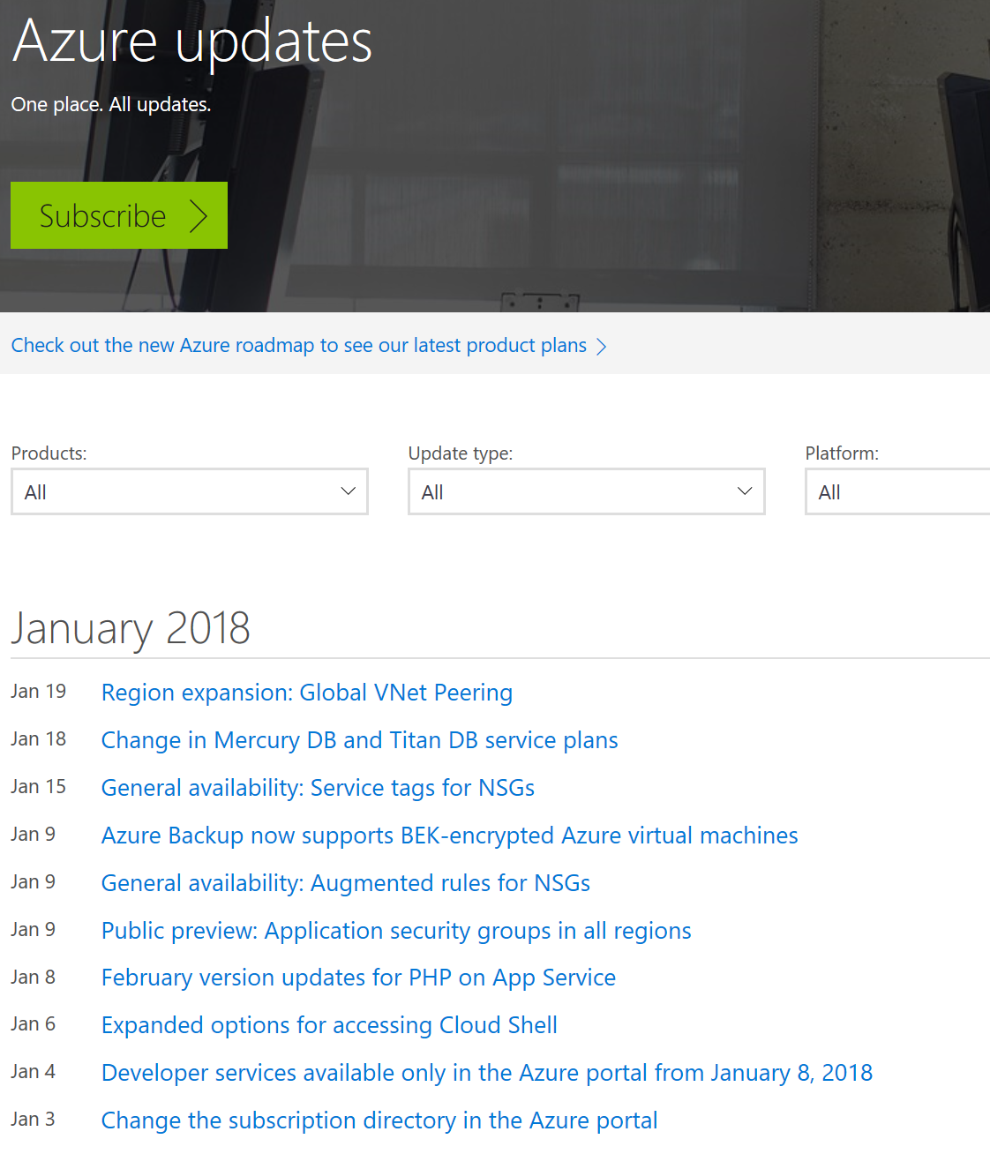
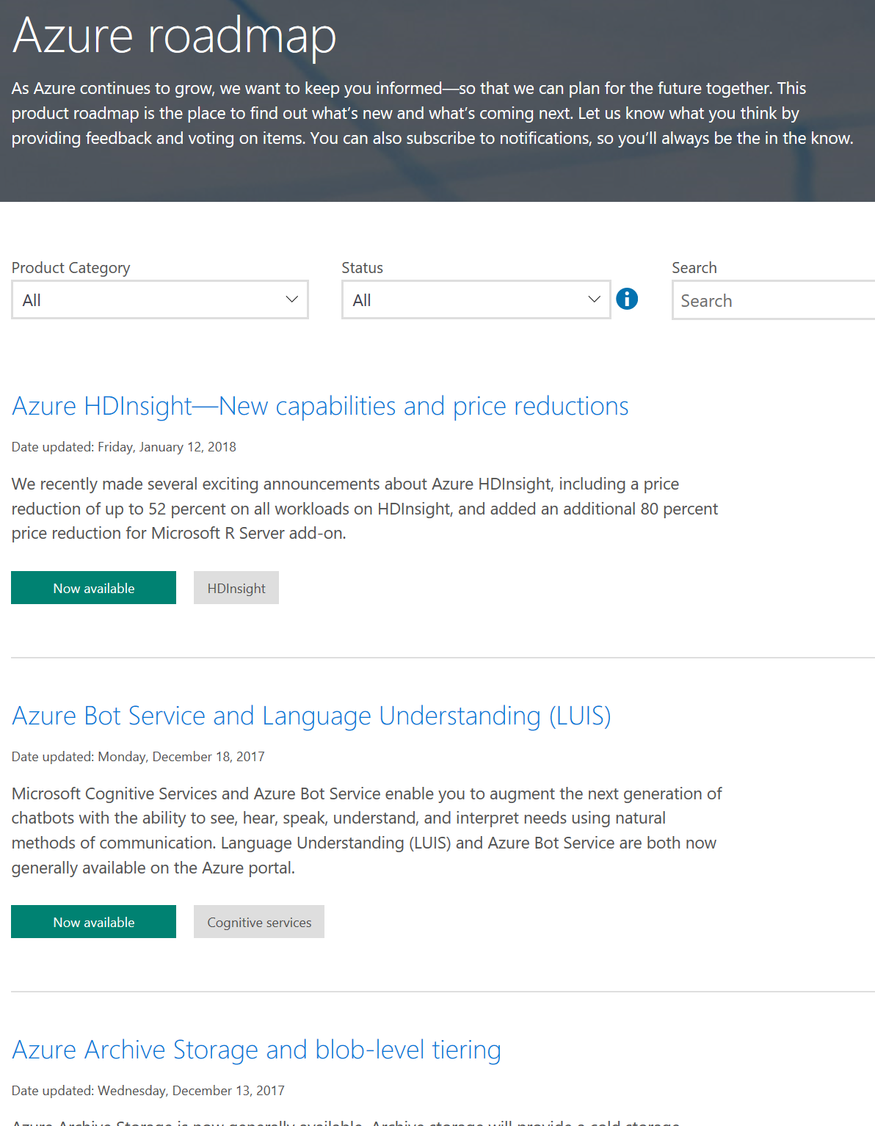
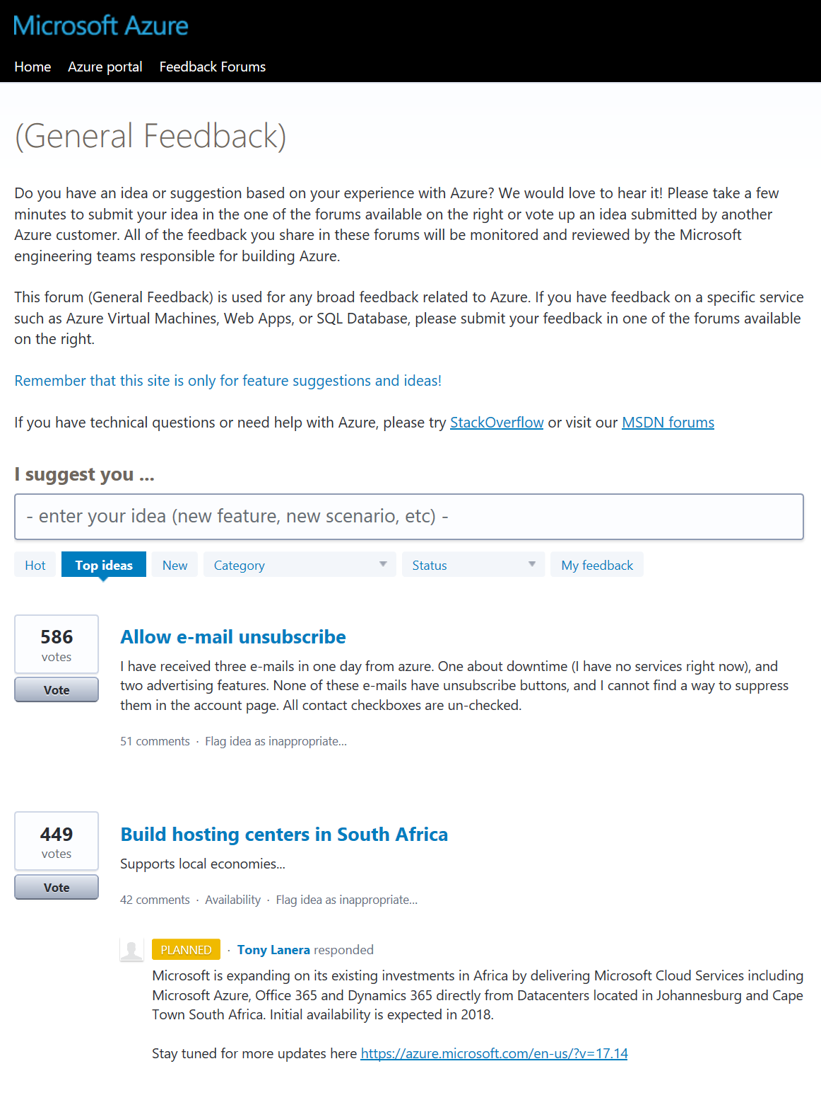
New Features
What we did…
What we are planning…
What you want us to do…
https://azure.microsoft.com/updates
https://azure.microsoft.com/roadmap
http://feedback.azure.com

Slide 19
Containers

Slide 20
Containers on Windows and Linux
Windows
Process
Windows Server Container
Hyper-V Container
Virtual Machine
Shared Kernel
Linux
Process
Linux Container
Virtual Machine
Shared Kernel
Less Overhead Better Isolation & Security

Slide 21
Unique benefits enabled by containers
Immutable environment
Container image has all application dependencies
High portability limiting “works on my machine”
Resource governance
Declarative resource limits for memory, cpu, io, etc.
Service Fabric offers this for *all* services (containerized or not)
Isolation
Containers spoof isolated OS instance
Limit impact of other applications in other containers

Slide 22
Azure Container Service (ACS)
Quickly deploy a production ready Kubernetes, DC/OS, or Docker Swarm cluster

Slide 23
Azure Container Service (AKS) – Managed K8S
Easy to use
Fastest path to Kubernetes on Azure
Up and running with 3 simple commands
Easy to manage
Automated upgrades and patching
Easily scale the cluster up and down
Self-healing control plane
Uses Open APIs
100% upstream Kubernetes
You only pay for the VMs running your containers!

Slide 24
Azure Container Instances (ACI)
You deploy your docker containers.
Windows or Linux
Pay for the CPU and Memory you request, billed by the second.

Slide 25

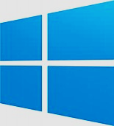

Service Fabric
Web Apps
ASP.NET Core
- OWIN
Reliable Actors
Guest Executables
(Any Code)
Reliable Services
Containers
Lifecycle
Management
Always On Availability
Programming Models
Health & Monitoring
Dev & Ops Tooling
Auto
scaling
Orchestration
Dev Box
Azure
On Premises
On Other Clouds

Slide 26
Azure App Service
Web App/Svc Hosting
Built in tooling for web scenarios
Load Balancing, Auto Scaling
Purchase by the VM
Windows and Linux
Supports .NET, Java, Node, PHP, Python, HTML & more

Slide 27


Azure Functions
Serverless, pay only when your code is running
Triggered by actions
Http request, file in storage, message in queue, etc.
Code
Azure Functions
Events + data

Slide 28
ACI Demo
az group create --name abContainerDemoRG --location eastus
az container create --resource-group abContainerDemoRG --name abcontainer --image microsoft/aci-helloworld --ip-address public --ports 80
az container show --resource-group abContainerDemoRG --name abcontainer
az group delete --name abContainerDemoRG --no-wait -y
https://docs.microsoft.com/en-us/azure/container-instances/container-instances-quickstart

Slide 29
Blockchain: Beyond the Hype
Shawn Weisfeld
Cloud Solution Architect
Microsoft
10:00 – 10:20

Slide 30
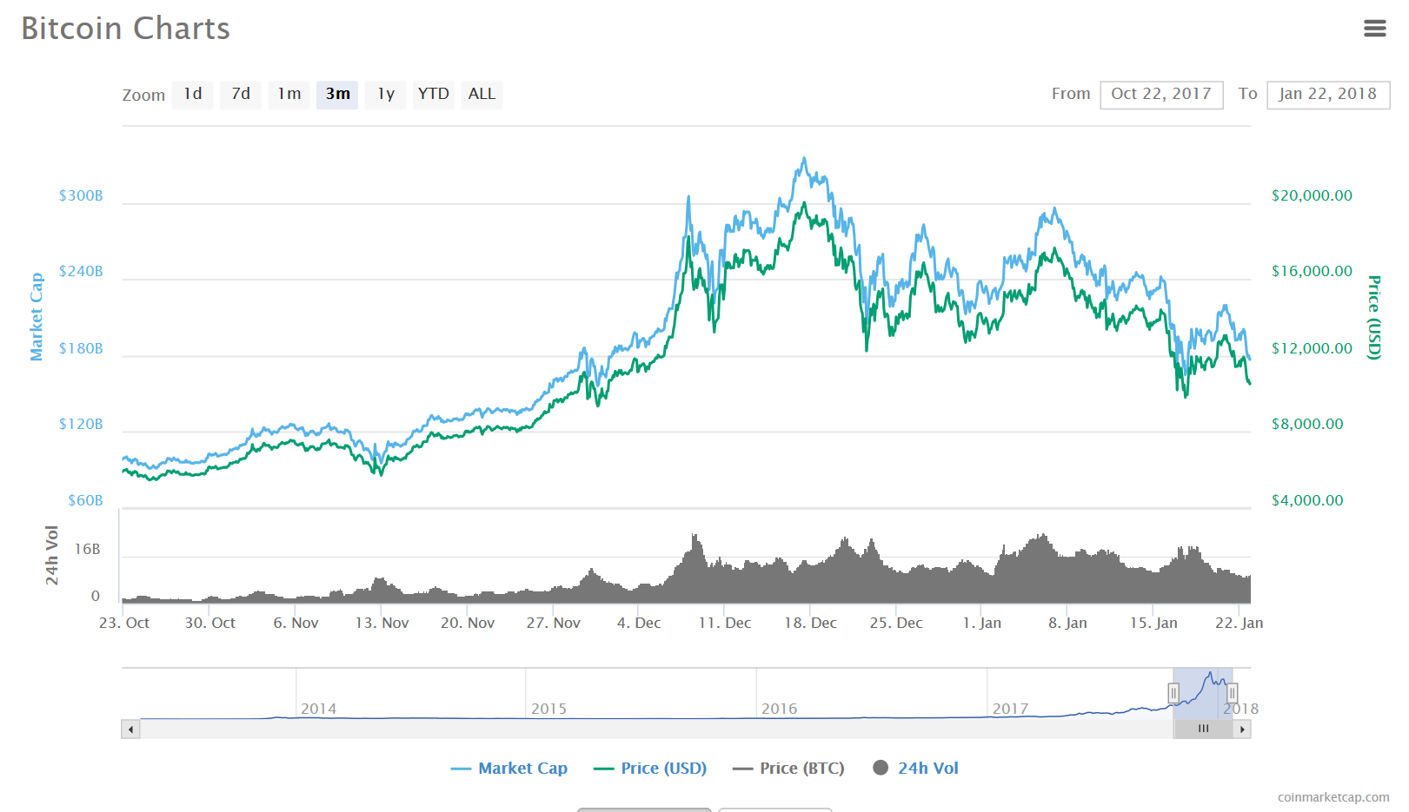
Bitcoin Market Cap
Last 3 months retrieved on 1/22/2018 – Source: https://coinmarketcap.com

Slide 31
Bitcoin
Bitcoin is a cryptocurrency and worldwide payment system. It is the first decentralized digital currency, as the system works without a central bank or single administrator. The network is peer-to-peer and transactions take place between users directly, without an intermediary. These transactions are verified by network nodes through the use of cryptography and recorded in a public distributed ledger called a blockchain. Bitcoin was invented by an unknown person or group of people under the name Satoshi Nakamoto and released as open-source software in 2009.
Source: https://en.wikipedia.org/wiki/Bitcoin

Slide 32
Blockchain
A blockchain is a decentralized and distributed digital ledger that is used to record transactions across many computers so that the record cannot be altered retroactively without the alteration of all subsequent blocks and the collusion of the network
Source: https://en.wikipedia.org/wiki/Blockchain

Slide 33
Blockchain | Advantages
A cryptographically secure, shared, distributed ledger
Secure
Shared
Distributed
Ledger
Each transaction recorded in the database is digitally signed and mathematically guaranteed to be authentic and impervious to fraud.
The database’s main value is that it is shared between separate entities
More entities shared, the greater the value.
Many copies of the database exist and they are replicas of each other in relative time.
A write once, thus immutable, ledger that records every transaction.
The entire history of all transactions is available, math doesn’t lie and there is no where to hide.

Slide 34


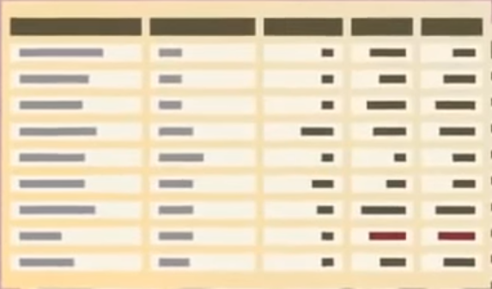



Decentralizes data in a trustless environment
Traditional ledgers are centralized and use third parties and middlemen to approve and record transactions
Blockchain safely distributes ledgers across the entire network and does not require any middleman
The technology maintains multiple replicas like P2P torrent file sharing
Traditional System
Blockchain System
Centralized system with stored ledger
Distributed system with distributed ledger

Slide 35
Ledger: Blockchain uses a distributed ledger to track transactions
A ledger is a write only database most commonly used in accounting
The digital distributed ledger creates the same copy of the data across all the participating nodes
All new transactions are digitally signed and then broadcast across the blockchain network to be added to the system
Participants in the blockchain verify the transaction is valid and then writes it to the ledger
FROM | TO | PROPERTY | VALUE
Alex | Katie | Payment | $500
Jim | Sally | Payment | $300
Alex | Garth | Asset | Car
Katie | Tony | Payment | $100
Molly | Paula | Message | I love you
Example ledger
Entire network has same ledger

Slide 36
Blockchain | Network Types
Public
Private
Consortium
Public blockchain
Persona
Woodgrove Financial
Person B
Northwind Traders
Bank 6
Bank 1
Consortium 6
Bank A Blockchain
Location 1
Location 2
Location 3
Location 4
Department A
Department B
Consortium
Woodgrove Financial
Contoso Bank
Northwind Traders
Bank b
Insurance c
Investment consortium c
Many, unknown participants
Writes by all participants
Reads by all participants
Consensus by Proof of Work
Known participants from one organization
Write permissions centralized
Reads may be public or restricted
Multiple algorithms for consensus
Known participants from multiple organizations
Writes require consensus of several participants
Reads may be public or restricted
Multiple algorithms for consensus
Source: Ethereum blog by Vitalik Buterin https://blog.ethereum.org/author/vitalik-buterin/

Slide 37




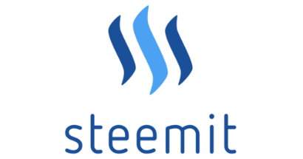




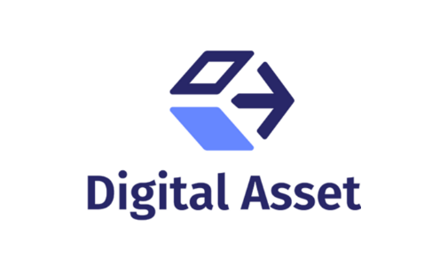


Blockchain | Multiple Chain Types
Blockchains
General Propose Chain
(cryptocurrency)
(cross-industry collaborative)
Alternative blockchains (altchains)
General Propose Chain
(cross-industry collaborative)
(Social News
Blockchain DB)
(Decentralized
Transport)
(IBM Open Blockchain )
(FSI consortium)
open platform for
developers and devops
to build blockchain apps
(banking industry collaborative)

Slide 38
Potential Benefits of Blockchain
Eliminates Intermediaries increasing efficiency and speed
Reduces Fraud related to data integrity
Operation simplification by helping to reduce cost and time related reconciliations and disputes
Helps Increase Revenue from new business model and saving

Slide 39
How does it work?

Slide 40
Evolution of Blockchain
Blockchain 1.0 – A simple ledger
Blockchain 1.0
Simple Ledgers that record transactions

Slide 41

EXAMPLE
Basic blockchain to track financial transactions
In this example, Alex wants to send Katie $500 via a financial transaction blockchain system
Tx
FROM | TO | PROPERTY | VALUE
Alex | Katie | Payment | $500
Tx
Signature
Signature
Tx
Signature
Tx
Signature
Transaction (Tx)
From: Alex (0xf5e…)
To: Katie (0x992…)
Amount: 500
Tx
2. Transaction is confirmed through mining.
Tx
Signature
Tx
Digital signature 0x23e423s3234…
Signature
Signature
1. Transaction information goes through hash functions (to secure it as well as create a time stamp)
3. Confirmed transaction gets pushed to network

Slide 42
Blockchains create a transaction chain that maintains the history of ownership of an asset
The ledger itself does not keep track of digital asset account balances, it simply records transactions.
Instead of balances, ownership of digital assets is verified by links to previous transactions, using the immutable history inherently available in a blockchain solution.
For example. For Alex to send $500 to Katie, he must reference previous transactions where he has received $500 or more to demonstrate that he, indeed, has that much money to send. These reference transactions are called previous input transactions. The current transaction(s) is called output transaction(s).
Validity of each transaction is based on the validity of previous transactions, which is shared.
Previous transactions
Transaction
From: Garth (0xas2…)
To: Alex (0xf5e…)
Amount: 200
Inputs: 0xtd6…, 0xj7d…
Current transaction
Transaction
From: Alex (0xf5e…)
To: Katie (0x992…)
Amount: 500
Inputs: 0x56e…, 0x987…
Transaction
From: Sally (0xkj5…)
To: Alex (0xf5e…)
Amount: 300
Inputs: 0xkf7…, 0x9dh…
Digital signature 0x56e…
Digital signature 0x23e423s3234…
FROM | TO | PROPERTY | VALUE
Alex | Katie | Payment | $500
Digital signature 0x987…

Slide 43
Evolution of Blockchain
Blockchain 2.0 – Introducing Smart Contracts
Blockchain 2.0
+ Smart Contracts
Logic Tier
Blockchain 1.0
Simple Ledgers that record transactions

Slide 44
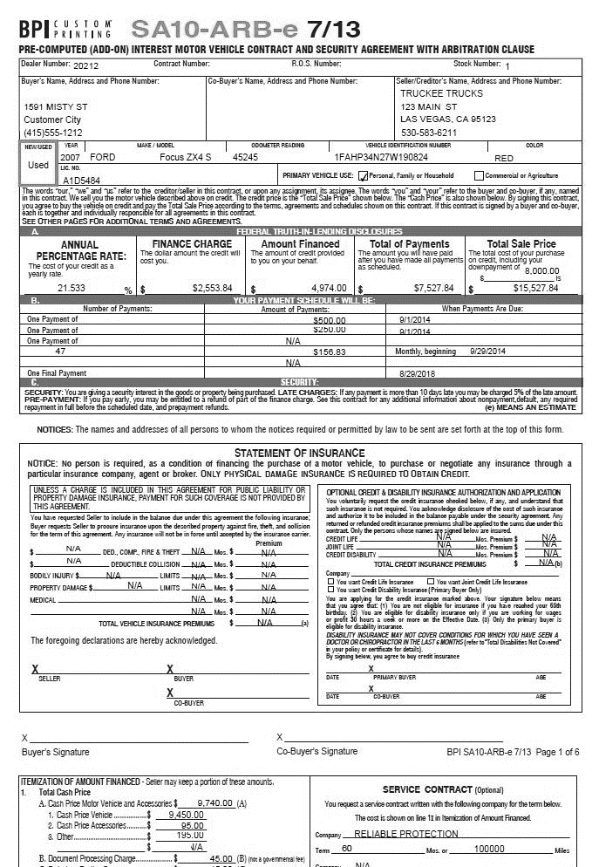

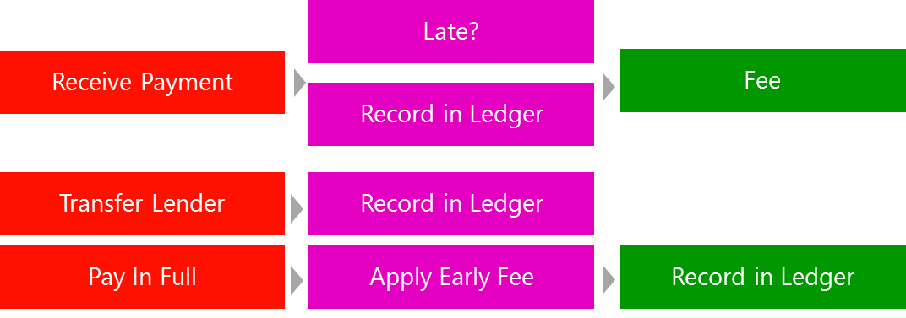

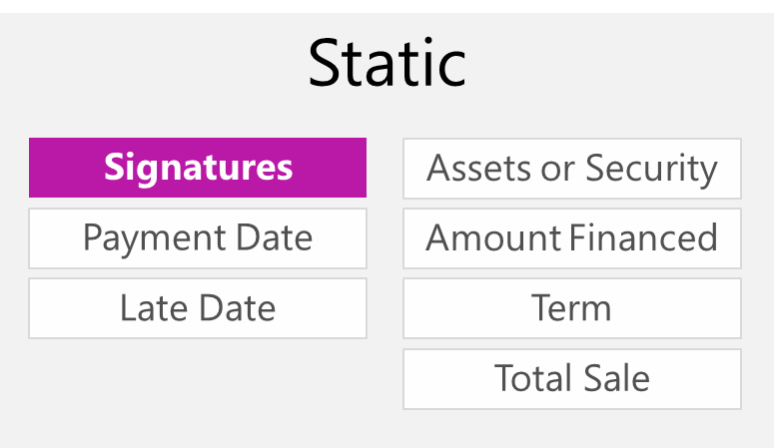
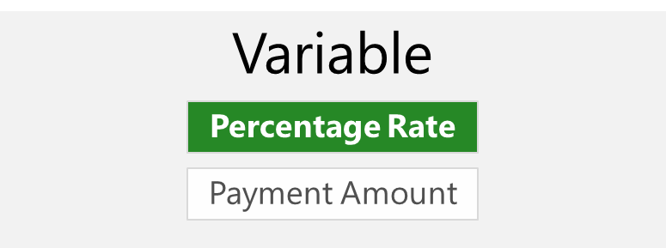
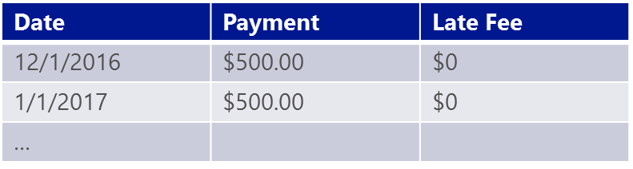
Blockchain 2.0 | Smart Contracts
Traditional Contract
Smart Contract Package
Deployed to Nodes
Logic
Properties
Ledger

Slide 45

Evolution of Blockchain
Blockchain 3.0 – Microsoft evolving the ledger to address the big problem
Blockchain 3.0
+ Cloud Servicing
Multilayer Middleware
+ Cryptlets
Blockchain 2.0
+ Smart Contracts
Logic Tier
Blockchain 1.0
Simple Ledgers that record transactions

Slide 46
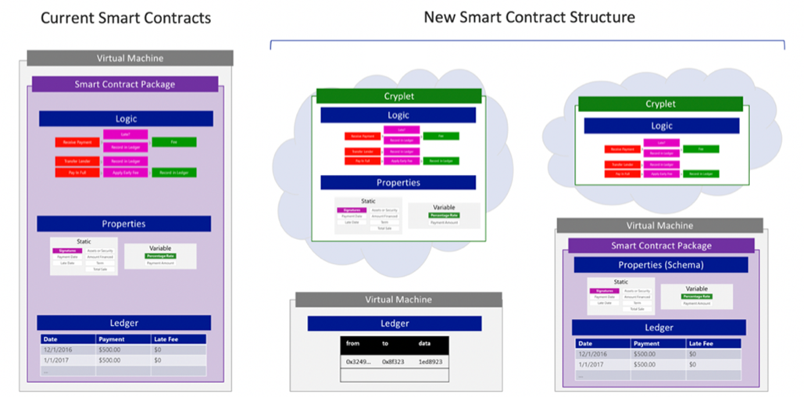
Blockchain 3.0 | State-of-the-art cryptlets innovation

Slide 47
Blockchain shows tremendous potential across industries
Manufacturing
Retail
Insurance
Banking and Capital Markets
Government
Health
Asset tracking
Real time auction for supplier contracts
Supply chain transparency
Loyalty tracking
Product provenance
Logistics management
Claims Management
MBS/Property Payments
Fraud detection
Automated underwriting
Bond Issuance
Trade Finance
Loan Syndication
Post Trade Settlement
Cross Border Payments
Derivatives Trading
KYC/AML
Licensing and ID
Benefits distribution
Aid tracking
Military security
Personalized medicine
Records sharing
Compliance

Slide 48




Market Challenges
HYPE
Lots of hype and noise.
IMMATURE Many offerings are immature and early.
NOT ENTERPRISE READY
Most technology providers don’t have enterprise DNA.
PATH TO PRODUCTION IS AMBIGUOUS Not always clear to go from concept to production.

Slide 49



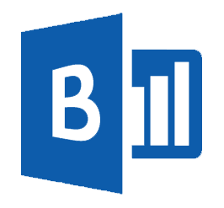
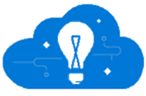
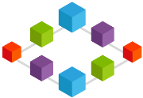



What do Blockchain Architectures look like?
Event Producers
Collection
Ingestor
(broker)
Transformation
Long-term storage
Presentation Layer
Stream Analytics
Modern Applications
Microsoft
Power BI based
Dashboards
Stream processing
HD
Insight
Storm
Event Hubs
Service bus
Azure DBs
Azure storage
HDInsight
SQL Data Warehouse
Azure Data Lake
Search and query
Modern
Applications
Cloud
Gateways
Business
Logic Apps
Microsoft Cortana Analytics
Notifications and workflow interactions on devices
Identity and Key Management
Functions
Blockchain
Communication with existing LoB via Industry Protocols or Enterprise Infrastructure
IaaS Hosted Code
Smart Contracts
Blockchain Ledger
Azure
Active Directory
Azure
Key Vault

Slide 50
Build development environment consisting of blockchain protocol clients and network infrastructure
Build Blockchain Network on premises/cloud providers: 3 weeks
Review blockchain protocol specific network documentation
Determine topology for a consortium network
Map topology to IT resources
Manually deploy
Configure blockchain clients via Linux BASH scripts to support private network (peering, isolate mining nodes, etc.)
Configure other blockchain protocol properties (consensus algorithms, max peers, etc.)
Trial and error to make above steps work
Configure IT networks and firewall ports to permit blockchain protocol traffic
Test, debug, and repeat
Deploy Blockchain Network in Azure using BaaS Bletchley Framework: 15 minutes
Activate Azure subscription
Search Azure Marketplace for desired blockchain
Click on blockchain image of choice
Provide 10 user parameters (number of consortium members, number of blockchain VMs, admin usernames and passwords, etc.)
Deploy and wait 15 minutes (+/- depending of nodes selected)
VS

Slide 51




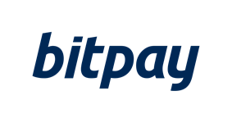


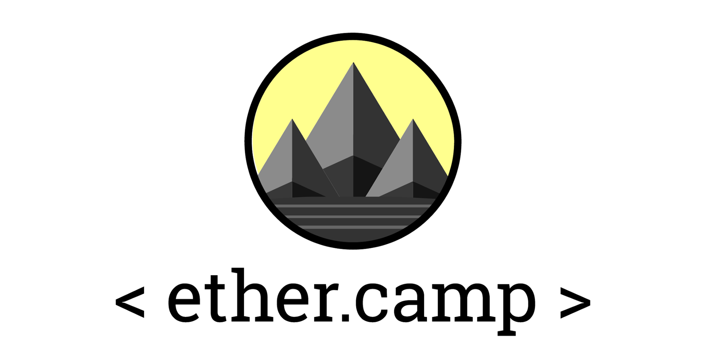










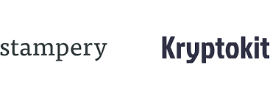

Why Microsoft for Blockchain?
Open Blockchain Ecosystem
Our platform will integrate with your investments
Regulatory and Compliance Ready (including Financial Services)
Azure

Slide 52
Tenets of our BaaS Strategy
FAIL FAST & CHEAP
in a development test environment
MIX & MATCH from the world-class blockchain technologies
CREATE & INNOVATE
by building solutions on blockchain quickly
SHARE SOLUTIONS through a worldwide distributed platform
PROVISION with one-click to test & iterate

Slide 53
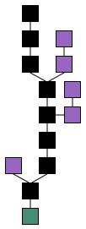
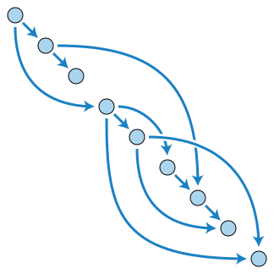
What is next?
IOTA - directed acyclic graph (DAG)

Slide 54
AI, ML, Big Data & IoT
Shawn Weisfeld
Cloud Solution Architect
Microsoft
10:20 – 10:40

Slide 55
IoT In Azure
Microsoft IoT Central
Fully managed SaaS
Best used when you need to get started quickly with minimal IoT experience
Azure IoT Edge
+
Azure IoT Suite
Customizable PaaS
On-premises processing
Best used when you need a lot of control over your IoT solution
+
Adds capacity to do local processing
Azure IoT Hub
Raw PaaS Services
Best used when you need even more control over your IoT solution

Slide 56
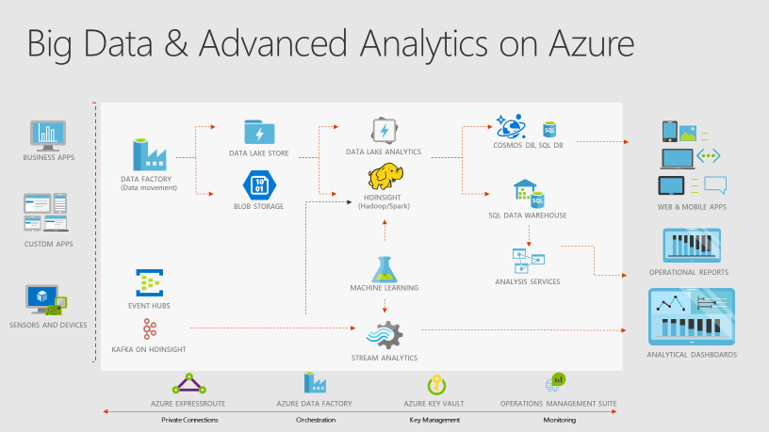
Big Data

Slide 57







Microsoft Cognitive Services
Give your apps a human side
Vision
Speech
Language
Knowledge
Search
Labs
Computer Vision
Content Moderator
Emotion
Face
Video Indexer
Bing Speech
Speaker Recognition
Bing Spell Check
Linguistic Analysis
Text Analytics
Translator Text & Speech
Web Language Model
Academic Knowledge
Entity Linking
Knowledge Exploration
Recommendations
QnA Maker
Bing Autosuggest
Bing Image Search
Bing News Search
Bing Video Search
Bing Web Search
Bing Entity Search
Project Prague (gesture)
Project Cuzco (events)
Project Johannesburg (routing)
Project Nanjing (isochrones)
Project Abu Dhabi (distance matrix)
Project Wollongong (location)
CUSTOMIZATION
Custom Vision Service
Custom Speech Service
Language Understanding
Custom Decision Service
Bing Custom Search

Slide 58






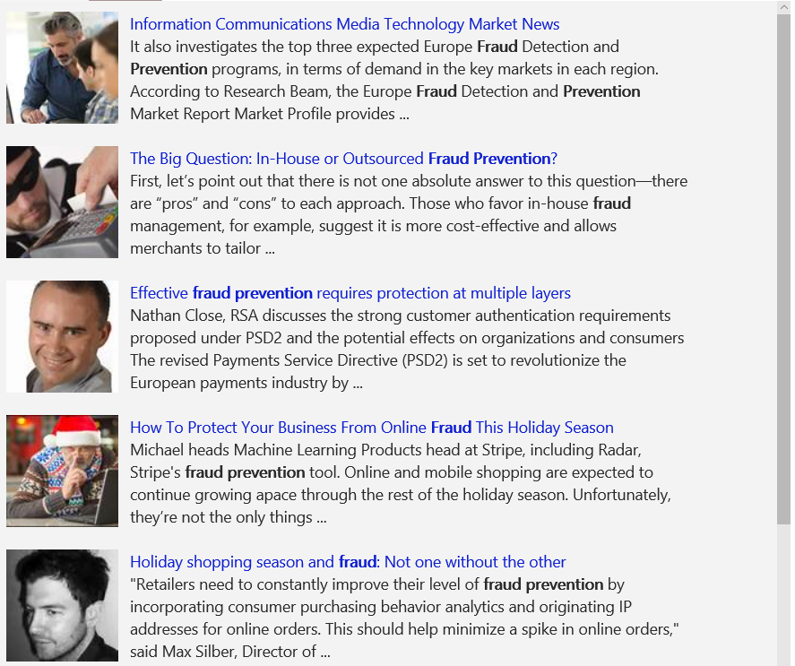
A variety of real-world applications
Vision
Speech
Language
Knowledge
Search
What is in the image?
Give me directions to the nearest local branch.
Play today’s customer call recording.
Top publications in customer lifecycle trends?
Search for ‘fraud prevention’
Computer Vision
Bing Speech
Language Understanding
Knowledge Exploration
Bing News Search
Natural Language Processing
Here are the top results:
Here is what I found:
Intent: PlayCall
Content: Customer#
DateTime.date: today
Customer Relationship Management – 5 Key Trends for 2014 CRM
Oct 28, 2015 – Here are FIVE key trends in 2014 that would help marketers in rolling ... Of late, marketers are looking at customer lifecycle management (CLM)
Information Communications Media Market News
It also investigates the top three expected Fraud Detection and Prevention programs, in terms of demand in key markets…
Predictive Customer Lifecycle Management (CLM)
The purpose of Customer Life-cycle Management (CLM) is to maximize both customer retention and .... Predictive trend analysis provides business visibility.
The Big Question: In-House or Outsourced Fraud Protection?
First, let’s point out that there is not one absolute answer—there are “pros” and “cons” to each. Those who favor in-house…
Category | People; 5 faces
Adult/Racy? | False/False
Dominant colors
Accent color
Convert spoken audio to text
Trends 2016: The Future of Customer Service
Jan 5, 2016 – The top 10 customer service trends for 2016 that .... North American Consumer
How to Protect Your Business from Online Fraud this Holiday Season
Michael heads fraud prevention tool. Online and mobile shopping are expected to continue growing apace…
Convert text to spoken audio
Now Playing
Extract intent of user
11/29/2016 Customer Call
Language Around Customer Lifecycles in the Banking Industry
View PDF
Face Demo: https://azure.microsoft.com/en-us/services/cognitive-services/face/
Video Indexer Demo: https://www.videoindexer.ai/media/1b4b02616d/

Slide 59
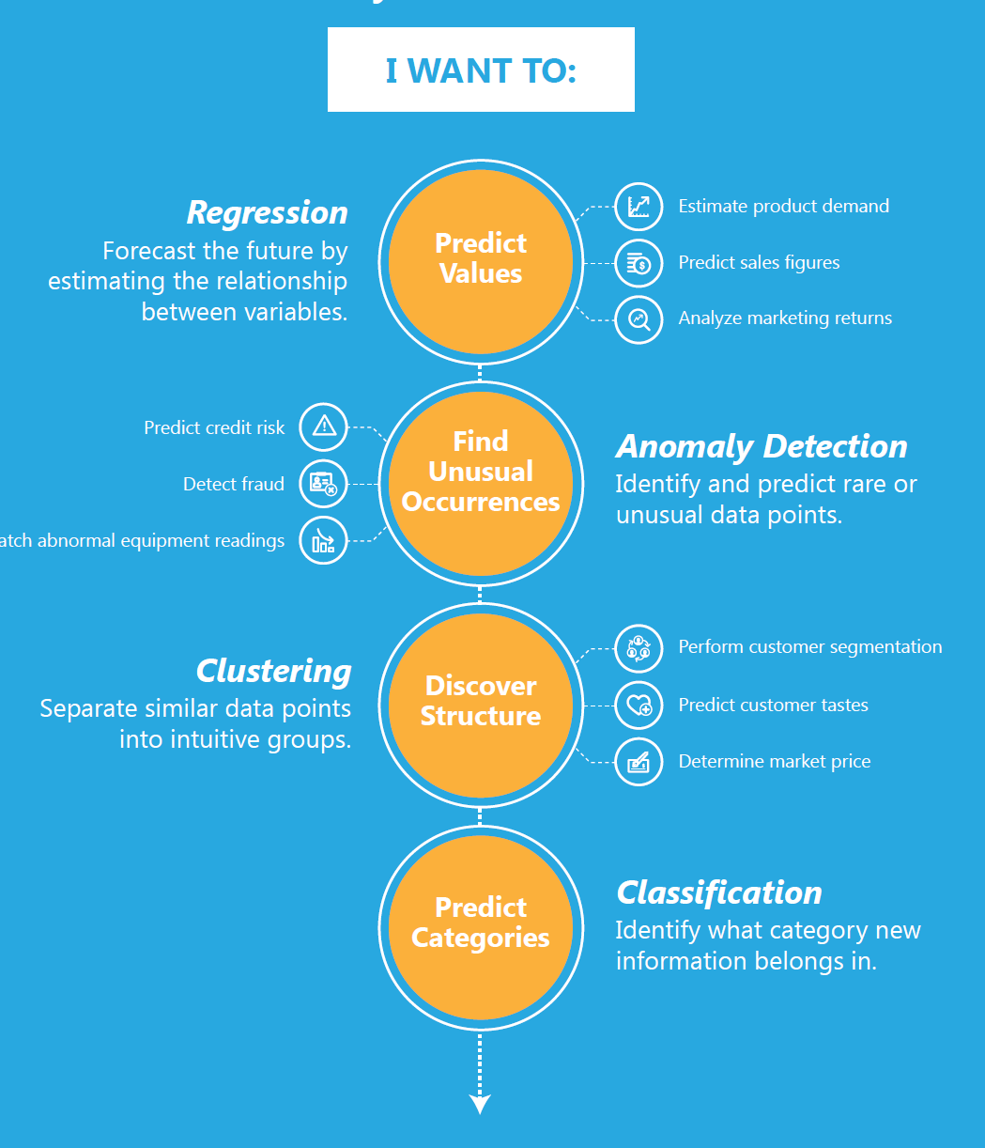
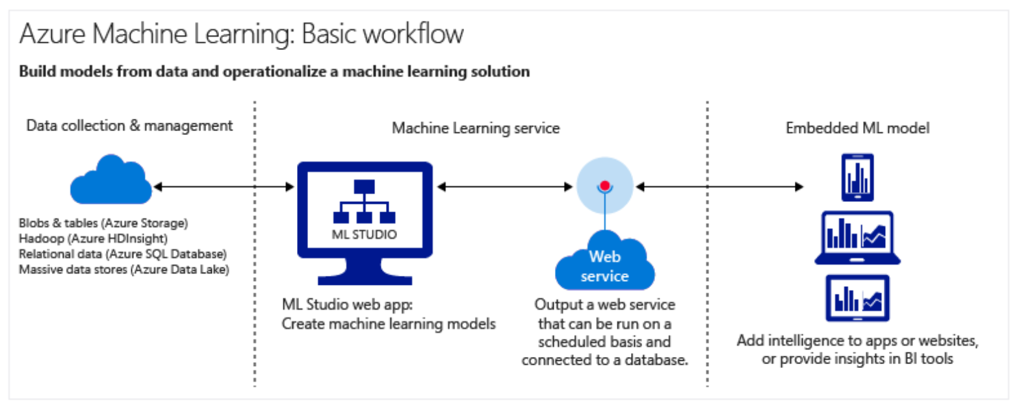
Machine Learning
Use existing data to forecast future behaviors, outcomes, and trends
Demo: https://gallery.cortanaintelligence.com/browse
MNIST

Slide 60
Spectre and Meltdown
Shawn Weisfeld
Cloud Solution Architect
Microsoft
11:10 – 11:25

Slide 61
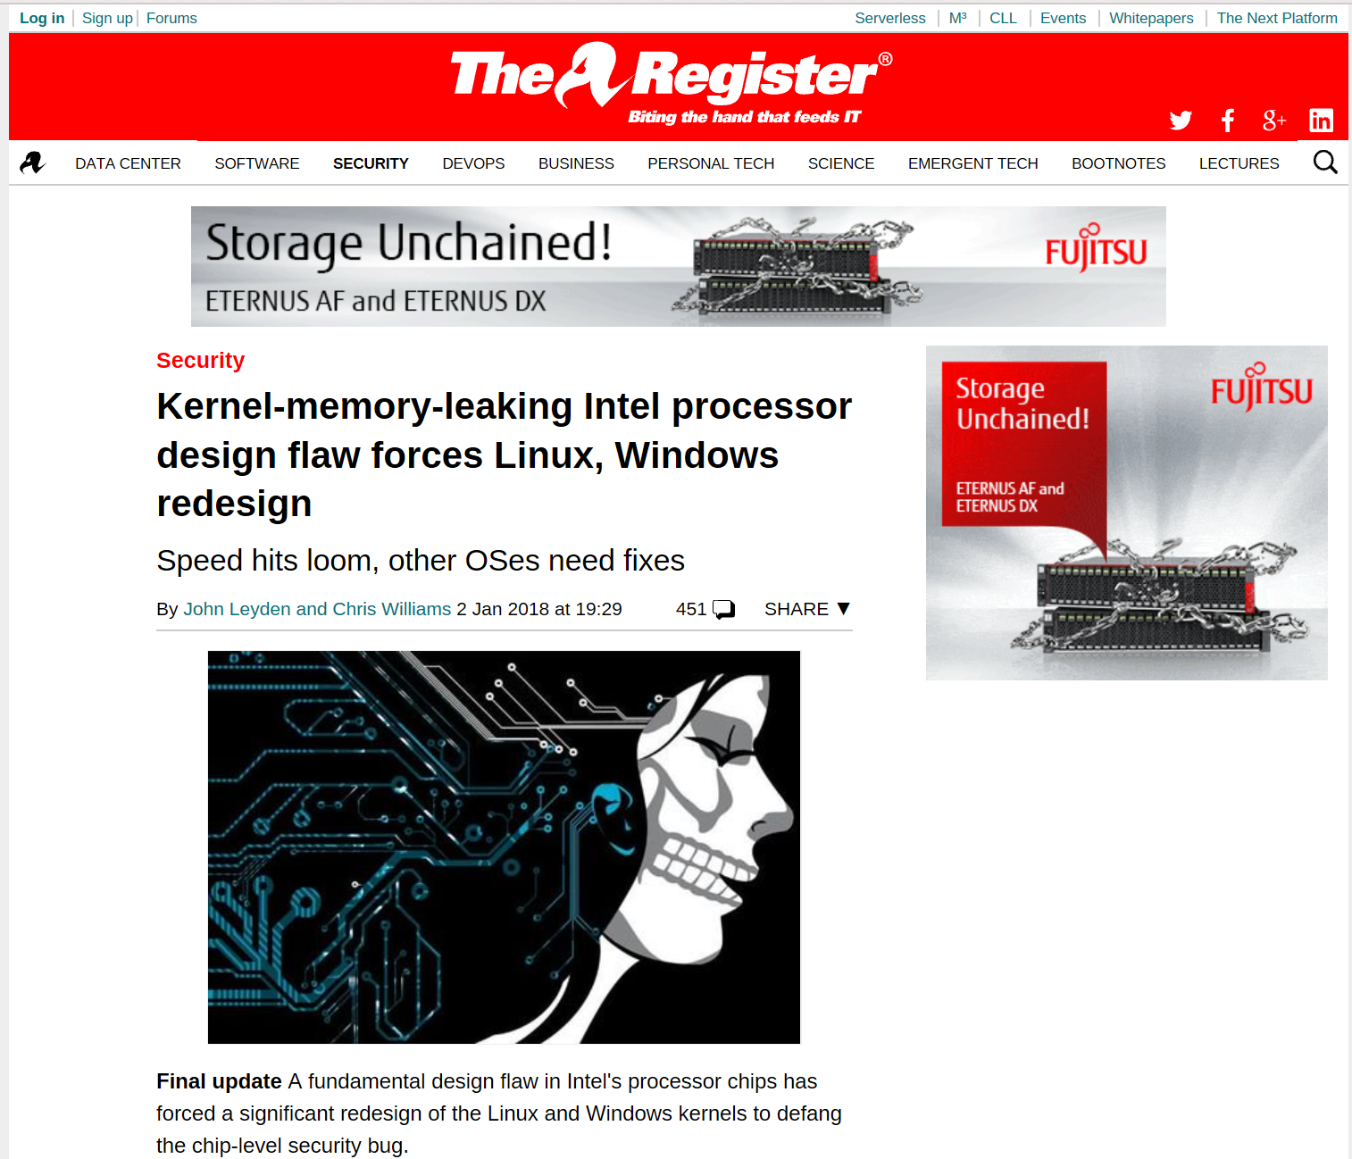

Slide 62
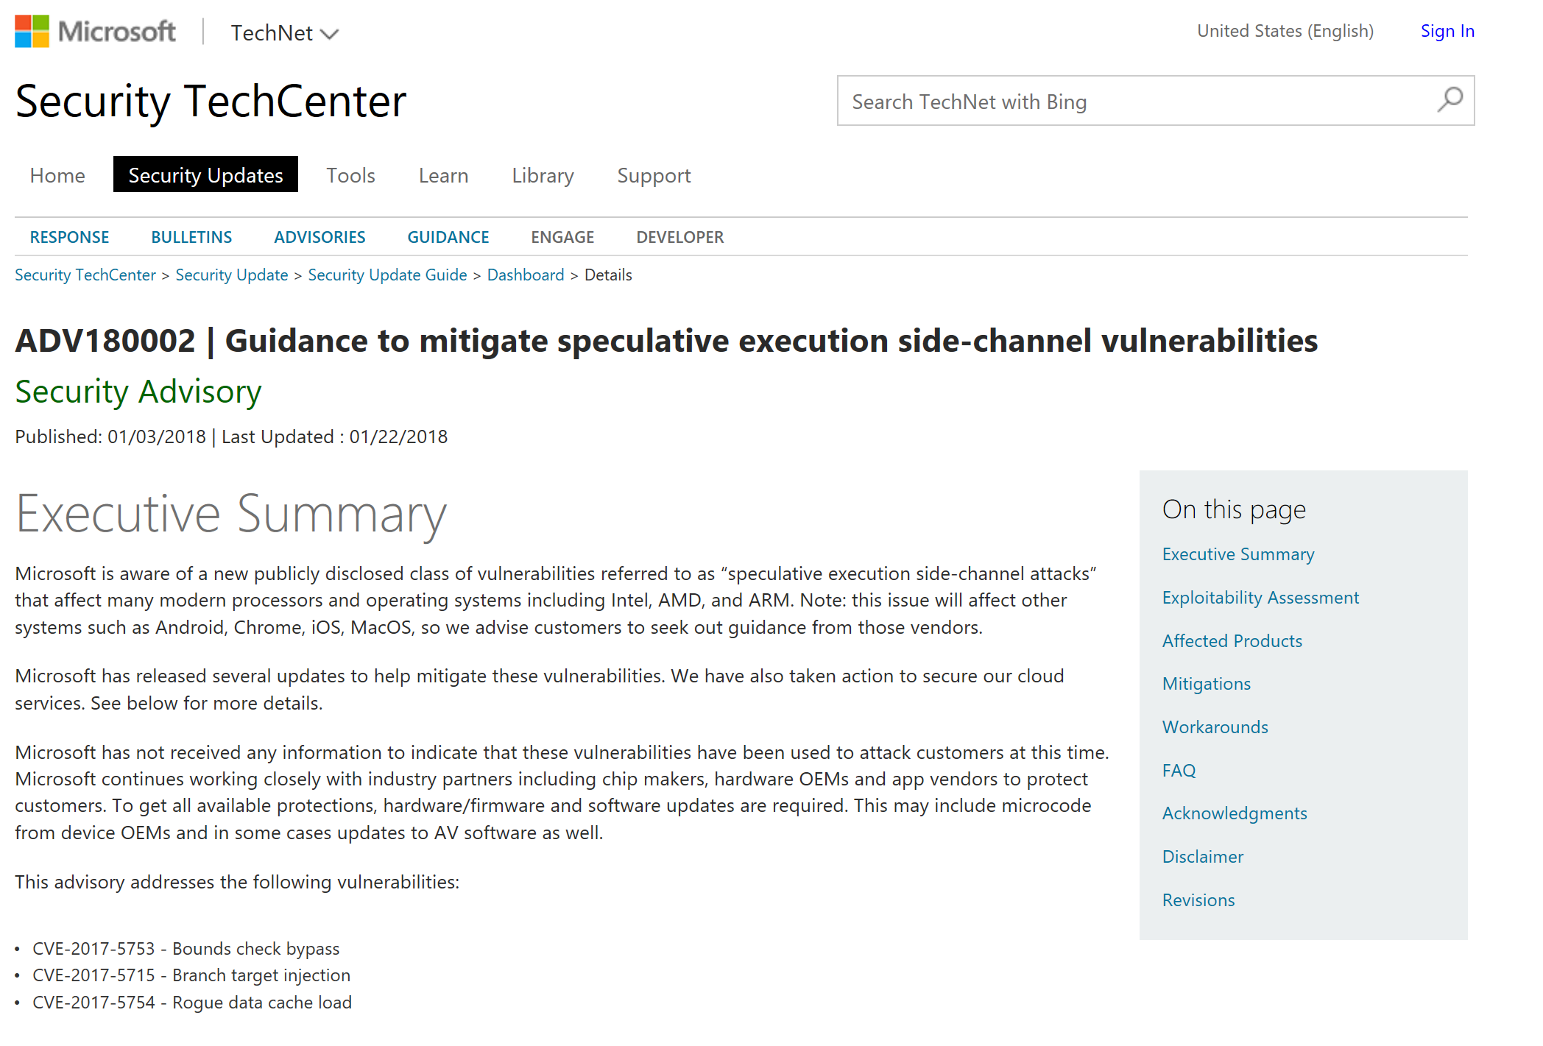
https://portal.msrc.microsoft.com/en-US/security-guidance/advisory/ADV180002

Slide 63
Issue summary:
We want fast computers
Data is moved from slower RAM to faster on chip memory to improve performance.
CPUs use a technique called “speculative execution” basically while the CPU waits for an answer from slow RAM, it will continue processing additional instructions.
If the CPU guessed correctly it is ahead of the game, and if it guesses wrong it just throws that work away.

Slide 64
Issue summary: (continued)
Side-channel vulnerabilities are ones where you look for a side effect to exploit sensitive information.
Now a bad actor can start poking around parts of memory that it shouldn’t have access to, and by watching the time it takes to get the value back, it can determine if it guessed correctly a value that was in the cache, all the while without being able to actually see the secret value.

Slide 65
What to do:
PATCH YOUR COMPUTER
Browser, Anti-Virus, OS & Firmware
Azure was already in the process of patching host infrastructure & PaaS Services when the issue was made public.
While an OS update is not required to isolate your applications running on Azure from other customers running on Azure, it is always a best practice to keep your OS versions up-to-date.
Azure: https://azure.microsoft.com/en-us/blog/securing-azure-customers-from-cpu-vulnerability/
On Prem: https://support.microsoft.com/en-us/help/4073757/protect-your-windows-devices-against-spectre-meltdown

Slide 66
Performance issues
Impacts of the patch vary based on your workload.
Most home/office & gaming workloads with newer chips see negligible impact.

Slide 67
Who has been attacked
Microsoft has not received any information to indicate that these vulnerabilities have been used to attack customers at this time.
(as of 1/22/18)

Slide 68

Meltdown
Meltdown breaks the most fundamental isolation between user applications and the operating system. This attack allows a program to access the memory, and thus also the secrets, of other programs and the operating system.
If your computer has a vulnerable processor and runs an unpatched operating system, it is not safe to work with sensitive information without the chance of leaking the information. This applies both to personal computers as well as cloud infrastructure. Luckily, there are software patches against Meltdown.
https://meltdownattack.com/

Slide 69

Spectre
Spectre breaks the isolation between different applications. It allows an attacker to trick error-free programs, which follow best practices, into leaking their secrets. In fact, the safety checks of said best practices actually increase the attack surface and may make applications more susceptible to Spectre
Spectre is harder to exploit than Meltdown, but it is also harder to mitigate. However, it is possible to prevent specific known exploits based on Spectre through software patches.
https://spectreattack.com/

Slide 70
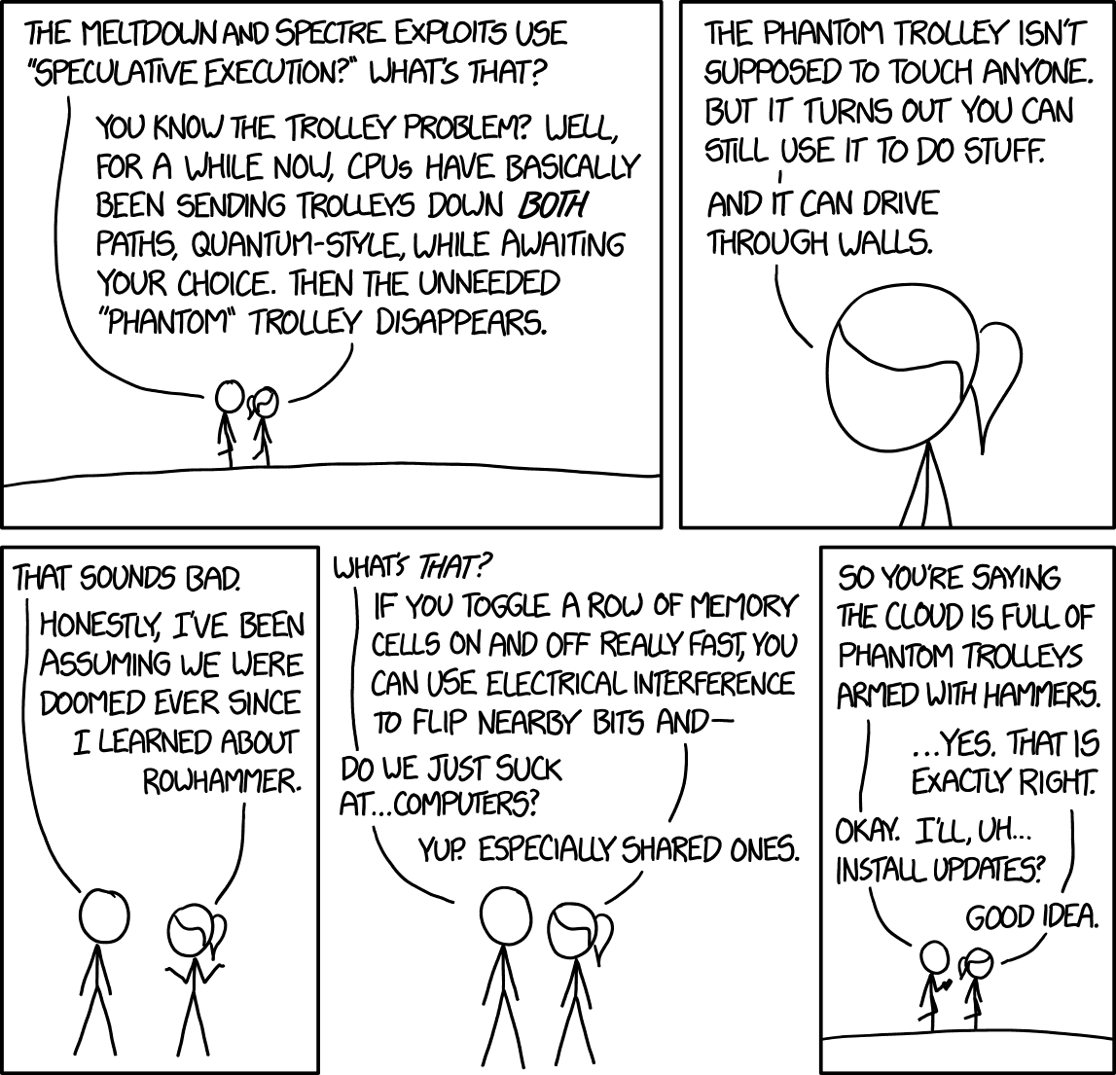
Source: https://www.xkcd.com/1938/

